Slide 1
Dispute Resolution and Professional Responsibility
@ uOttawa
Professor Ellen B. Zweibel
Professor John Manwaring
Professor Marina Pavlović
Professor Peggy Malpass

Slide 2
OBJECTIVES
Demonstrate how ethics and professional responsibility are taught pervasively in a first year mandatory dispute resolution course using face-to-face activities blended with online activities and multi-media
Demonstrate the benefits of teaching ethics pervasively and using blended learning

Slide 3
OBJECTIVES
Design your own blended-learning and multi-media approach to achieve a specific ethics and professionalism learning objective
Identify the ways that ethics and professionalism can be integrated into any subject area to accelerate the theory-practice transfer of knowledge and skills

Slide 4
SESSION AGENDA
Overview of the Dispute Resolution and Professional Responsibility (DR&PR) first year course at uOttawa
Activity Part 1: Identify an ethical or professionalism issue to teach
DR&PR Pedagogy & approaches
Activity Part 2: Design a teaching activity applying “high road transfer” principles

Slide 5

BACKGROUND

Slide 6
DISPUTE RESOLUTION AND PROFESSIONAL RESPONSIBILITY @ UOTTAWA
Our vision of dispute resolution integrates a commitment to social justice, public interest and high ethical standards.
Ethics and professionalism are taught explicitly and pervasively as elements of core competencies, such as interviewing, problem solving, transaction facilitation, advocating for client interests in negotiation, mediation and arbitration processes.
First Year Mandatory course 300 English and 85 French Program students

Slide 7
ETHICS AND PROFESSIONALISM
Life Long Ethics Learners:
Habit of Reflecting
Baseline knowledge of the Rules of Professional Conduct
Emerging tort, criminal and malpractice principles applied to professional conduct
Develop own ethical
framework
Recognize and deal with situtational pressure
Equipped to think critically about ethical choices they will have to make

Slide 8
ETHICS AND PROFESSIONALISM
Life Long Ethics Learners:
Habit of Reflecting
Baseline knowledge of the Rules of Professional Conduct
Emerging tort, criminal and malpractice principles applied to professional conduct
Develop own ethical
framework
Recognize and deal with situtational pressure
Equipped to think critically about ethical choices they will have to make

Slide 9
FIRST YEAR: DISPUTE RESOLUTION AND
PROFESSIONAL RESPONSIBILITY
Ethics and Professionalism
Dispute Resolution Processes
    Distinguishing Interests from Positions
  Interviewing, Negotiation, Mediation, Arbitration
  Communication Skills
Effective Oral and Written Advocacy in Non-Litigation Forums
Integrated with Primarily Property Course Topics

Slide 10
ACTIVITY PART 1:
IDENTIFY YOUR LEARNING TOPIC

Slide 11
YOUR TASK:
Jot down ethics or professionalism topic or a problem that
  You would like to teach in the future, or
  You currently teach but would like to teach differently
  Identify a substantive subject area to teach it in

Slide 12
DISPUTE RESOLUTION AND PROFESSIONALISM PEDAGOGY
EXAMPLES

Slide 13
TRANSFER OF LEARNING
Goal: Far transfer
Enabling students to exercise higher levels of cognitive skills such as problem identification, problem solving and decision-making in unforeseen real world situations
Mechanism: High Road Transfer
Conscious application of abstract knowledge learned in one situation to new situations.

Slide 14
HIGH ROAD TRANSFER
Learning activities that encourage:
Explicit abstraction of critical attributes or underlying principles
Deliberate search for possible connections including comparisons with prior knowledge and experiences
Mindfulness or alertness
Metacognition: ability to
  reflect on one’s own thinking processes
  self-monitor and
  target improvement.

Slide 15
HIGH ROAD TRANSFER
Solid knowledge base
  Taught for understanding rather than rote recall
Sufficient time on the task
  Learners need time to reorganize the material covered
Identify patterns and make connections
Avoiding cognitive overload
Diverse practice
  Learning that is too context bound blocks flexibility

Slide 16
COURSE INSTRUCTIONAL METHOD
Active and experiential learning
  Simulations
  Small group activities
  Demonstrations
  Reflection Questions
  Practice, Reflect, Improve
Blended with Web-based on line instruction
  Content and activities
  Practice venue
Coaches
  Local practitioners
  Upper year Practicum students

Slide 17
BLENDED LEARNING
Active learning is the best use of limited classroom time
Theory and course content can be taught through web-based practice cycles
Skills introduced in the classroom can be reinforced through web-based practice activities that take advantage of interactive multimedia
Allows learners time for reflection
Time jealous law students prefer autonomy and flexibility

Slide 18


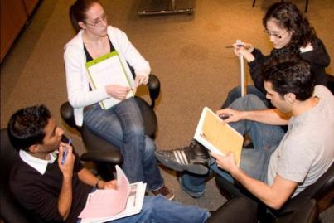

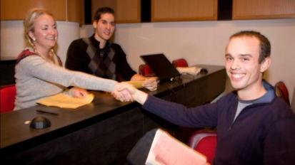





A SNAPSHOT OF STUDENT ENGAGEMENT

Slide 19
COURSE WEBSITE

Slide 20
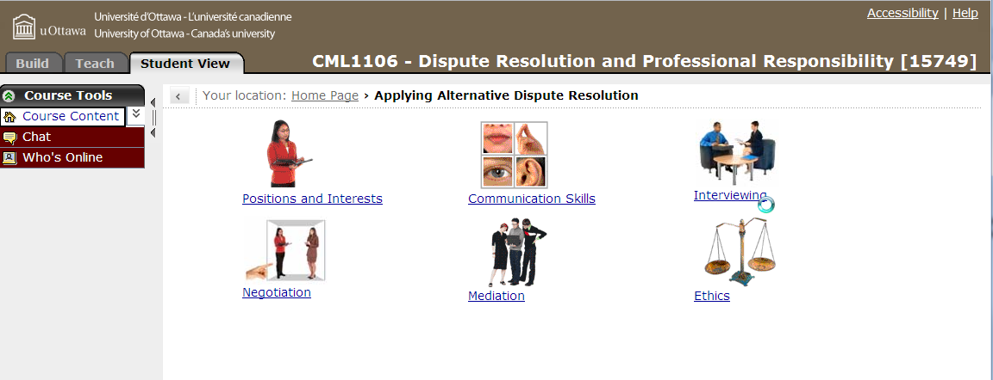
COURSE WEBSITE
Online modules have integrative theory and activity sections

Slide 21
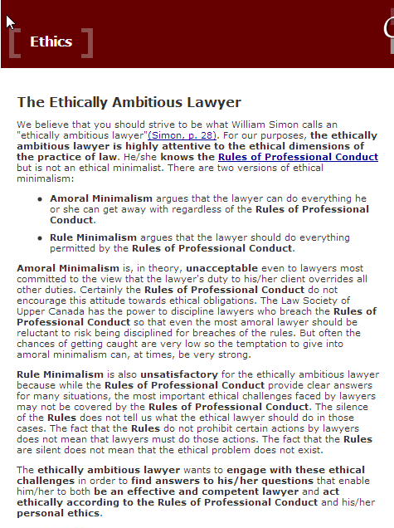
THEORY

Slide 22
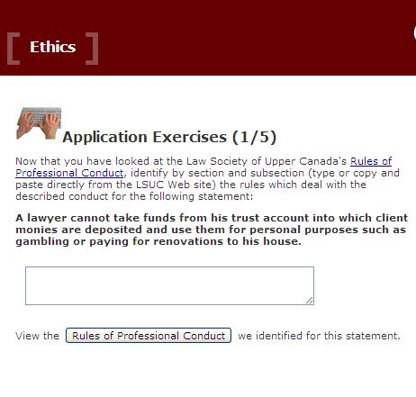
ACTIVITY

Slide 23
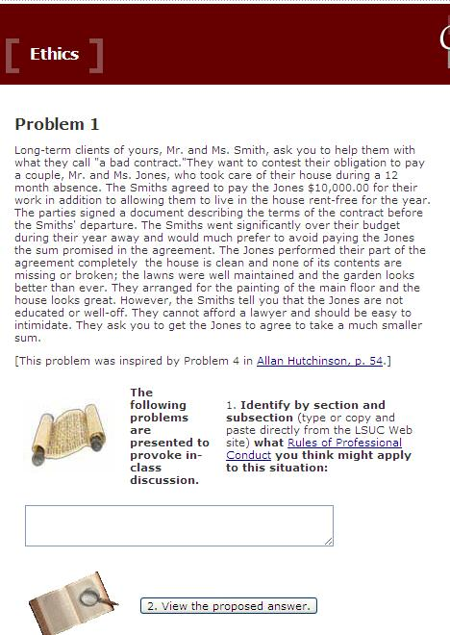
ACTIVITY

Slide 24
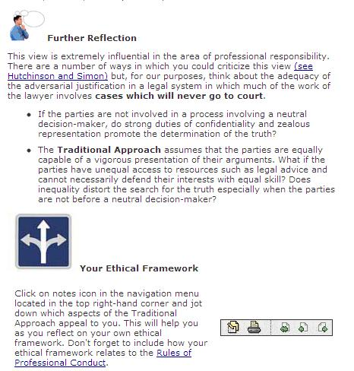
REFLECTION

Slide 25
ETHICS ACTIVITIES IN OUR COURSE

Slide 26
TERM STARTS WITH ETHICS AND PROFESSIONALISM
Today you begin your legal career
What ethical principles and conduct do you aspire to?
  Describe your ideal ethical lawyer
  What attributes are clients looking for in a lawyer?
  What conduct can lawyers expect from each other?
  What obligations should lawyers have towards the justice system?
  What obligations should lawyers have Towards society at large?

Slide 27
GRAPPLING WITH ETHICS IN THE VERY FIRST CLASS
You are negotiating the sale of a client’s business. Six months ago, you gave the purchaser accurate business financial statements. Recently the market has weakened. Your client gives you new information that certain sales fell through and an important client is bankrupt.
Revealing this will certainly affect the price. The purchaser, represented by a young lawyer, has not yet requested updated information. The draft contract does not have a due diligence clause, so the onus is currently on the purchaser to fully investigate all the purchase details.

Slide 28
WRITTEN ASSIGNMENT
GRADED Pass Fail (B IS A PASS)
Complete the Online Ethics Module
Practice Scenarios: For each scenario
Identify the ethical issues raised. Identify some Rules of Professional Conduct that you think might apply.
Write down what you would do in response to each situation.
Explain how your response reflects the four approaches to professional ethics and your ethical framework.
Prepare to discuss with two classmates, before joining in on a larger class discussion.

Slide 29
Scenario One: You and a colleague are working for the student book store. In reviewing the weekly accounts you notice a $500 shortfall between the retail value for books sold and the cash and cheques taken in. Panicked you show this to your colleague who says; “Don’t worry about that, I was a little short on my tuition payment and so I borrowed $500 until my student bursary comes in. Otherwise I couldn’t pay my rent. I should get the bursary cheque any day now.”
Scenario Four: In your job at the student legal aid clinic you are negotiating a settlement in a landlord tenant matter. Your client is being sued by his landlord for unpaid rent and damages done to an apartment. During the negotiation, you show the landlord a receipt for a month that the landlord has not credited to the tenant’s account. The landlord apologizes and makes the correction. In re-calculating the amount owing, the landlord makes a $500 mathematical error in your client’s favour and agrees to settle the matter for this amount.

Slide 30
Ethics and Professionalism
Identify and Apply Rules of Professional Conduct to ethical scenarios
Develop and apply a personal professional ethical framework
Construct a code of conduct for law students
Debate the role of social policy critique in legal analysis and advice

Slide 31
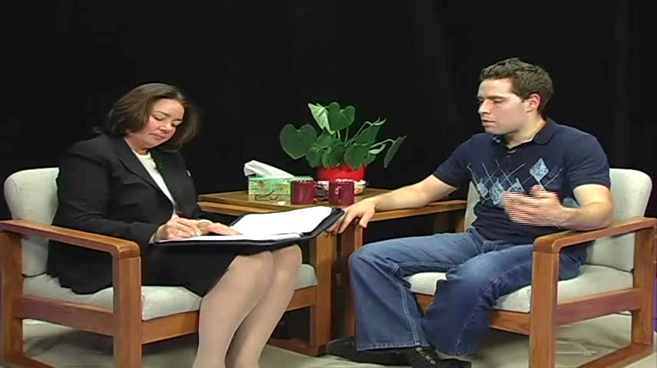
EMBEDDING ETHICS AND PROFESSIONALISM
Interview Demonstration
Student response sheet
7. Should you pursue the matter of the brother's gambling debts? Why or why not?

Slide 32
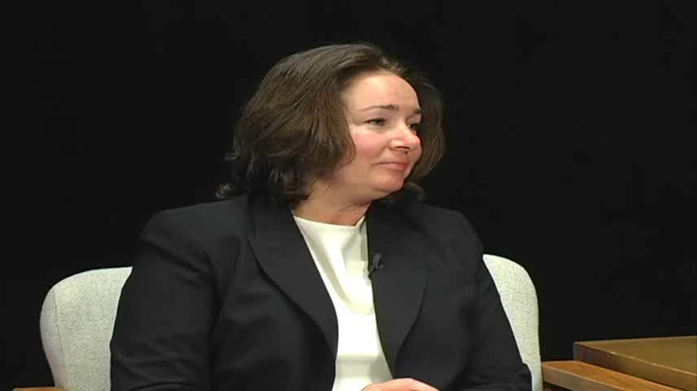
EMBEDDING ETHICS AND PROFESSIONALISM
Interview Demonstration
Student response sheet
8. How would you respond to the client's question? What issues or question does it raise for you?

Slide 33
DR IS EFFECTIVE AT RAISING
ETHICAL DILEMMAS
1. Puts the “Zealous Advocate” concept to the test in concrete situations where the other side’s interests must be met to conclude a deal
2. Lawyer- client relationship can “conflict” with duties to the profession and justice system
  Do you breach confidentiality to avoid deceiving others
3. Negotiation behaviours: Puffing, Bluffing, Failure to Disclose and Outright Lying
  Students deal with gradations and then re-exam if they agree with what they or others have done
  Students often revert to preconceived notions about negotiation behaviour and get immediate feedback from the situation itself. Example: Tit-for Tat

Slide 34
EMBEDDING: INTERVIEW CLIENT’S INSTRUCTIONS
Based on the legal memo, you feel fairly confident that Drey Kline’s original will created a joint tenancy between yourself and Pat Kline. You are however a little concerned about CICF’s second point regarding the negotiation in 2006 between yourself and Pat.
No one but you knows that during that negotiation, you and Pat agreed that each would own 50%. In fact you agreed to pay Pat $100,000 for his interest in about 4 years time. This was a verbal understanding. It is not written anywhere. You don’t know if Pat told anyone about the arrangement. Tell your lawyers that you do not want this information revealed to the other party in the negotiation. You think that if CICF knew, it would make CICF bolder in its claim for a 50% interest.

Slide 35
ETHICS IN NEGOTIATION
Small tells you that he has no intention of operating a candy company, but that he does want to purchase the site.
He tells you that in order to assist in completing the purchase, he has set up a shell corporation called Chris’ Candies, Inc., and you are free to approach Telemann on behalf of that company if you think it will help.
He authorized you to approach Telemann and to offer up to $10 million for the business, including the factory and site.
He warns you that if Telemann learns who really wants to buy the business and why, the price is apt to be prohibitive. He does not want the word to get out that Delta is searching for a development site in Perth, since that would drive up the price of other sites. Hence, under no condition are you to disclose Delta’s intended use of the property.

Slide 36
EMBEDDING: MEDIATION
Dead Maples:
Slater’s Client Instructions:
You admit, to your lawyer, that you did not specifically point out to B. Amigo how risky it was to use the Fern Leaf Japanese Maples. You do not want to admit this to B. Amigo. You feel you did your duty by telling him to redo the plans.
Amigo’s Client Instructions:
A few times, R. Slater tried to steer you towards ideas about what should go where, but you thought this was just another way to get you to consider hiring the firm to re-design the plan and you preferred to stick to Canto’s original plan. You admit to your lawyer that you really didn’t pay any attention to R. Slater’s ideas and do not really remember what was said. You do not want to admit this during the negotiation.

Slide 37
NEGOTIATION TACTICS SURVEY
You are about to enter into a negotiation. You will be negotiating for something which is very important to you and your business. Indicate your view of the appropriateness of using each of the following tactics in the negotiation on the scale below (1-7 scale)
Q4: Lead the other negotiator to believe that they can only get what they want by negotiating with you, when in fact they could go elsewhere and get what they want cheaper or faster.
Q 12: Intentionally misrepresent the nature of negotiations to the press or your constituency in order to protect delicate discussions that have occurred.

Slide 38
FINAL PAPER TOPIC: EXAMPLES
Explaining the thesis presented in an article or a series of articles and then using reflective examples from one’s own personal experiences in the course to support, refute or otherwise better understand the thesis.
The ethical rules that govern lawyers were written with the adversary system in mind and are inadequate and perhaps downright antithetical to the paradigm of the lawyer as dispute resolver. A separate, or at least supplemental, code for lawyers who represent clients in non-adversarial forums is required. Discuss
Discuss the concept of acting as a zealous advocate in the context of non-adjudicative processes
What does it mean for a lawyer to negotiate in good faith?

Slide 39
ACTIVITY PART 2:
DESIGN YOUR ACTIVITY

Slide 40
THE TASK:
In small groups choose one of your learning problems
  Design a learning activity that uses
  Face-to-face contact time; online resources, multimedia material
To encourage
Explicit abstraction of principles or critical attributes
Deliberate search for possible connections including comparisons with prior knowledge and experiences
Mindfulness or alertness
Metacognition:
    reflect on one’s own thinking processes
    self-monitor and
    target improvement

